Slide 1
NAME : S.S.DHANYA
3 YEAR B.E. CSE
REG NO: 211521105037

Slide 2

PROJECT TITLE : FAKE NEWS DETECTION USING RNN(RECURRENT NEURAL NETWORKS)

Slide 3
AGENDA:
Introduction to Fake News Detection
Importance of detecting fake news.
Objectives of the session.
RNN Overview
Explanation of RNNs.
Suitability for sequential data processing.
Data Preparation
Gathering diverse dataset.
Preprocessing steps.
Model Architecture
Designing RNN-based model.
Consideration of different RNN variants.
Training and Evaluation
Splitting dataset.
Training and assessing model performance.
Ethical Considerations
Ethical implications of automated detection.
Addressing biases and unintended consequences.

Slide 4
PROBLEM STATEMENT:
Develop an RNN-based algorithm to automatically distinguish between fake and legitimate news articles, addressing challenges such as subtle linguistic cues, temporal dynamics, generalization to diverse contexts, interpretability, and scalability.
The problem statement for this project is to develop a robust fake news detection system using Recurrent Neural Networks (RNNs). The goal is to design an algorithm capable of automatically distinguishing between fake and legitimate news articles based on their textual content.
Data Complexity: Fake news articles often exhibit subtle linguistic cues, making them challenging to differentiate from legitimate ones. The algorithm must effectively capture these nuances to make accurate predictions.
Temporal Dynamics: News articles are time-sensitive, and the prevalence of fake news may vary over time. The model needs to adapt to evolving patterns of misinformation and remain effective in detecting fake news across different time periods.
Generalization: The algorithm should generalize well to unseen data sources and news topics. It should not be overly reliant on specific features or characteristics present in the training dataset but rather learn robust representations of fake news across diverse contexts.

Slide 5
PROJECT OVERVIEW:
Project Overview: Fake News Detection Using RNNs
Objective: Develop a robust fake news detection system using Recurrent Neural Networks (RNNs).
Approach:
1. Utilize a labeled dataset of news articles.
2. Preprocess data and train RNN model variants like LSTM and GRU.
3. Evaluate model performance using standard metrics.
4. Analyze results and discuss implications for combating fake news.
Outcome: A powerful RNN-based tool to identify fake news, contributing to information integrity in the digital era.

Slide 6

WHO ARE THE END USERS?
End Users for Fake News Detection Using RNNs:
1. Social Media Platforms: To implement automated fake news detection systems, enhancing content moderation and promoting accurate information sharing.
2. News Aggregators: To filter out fake news articles from their platforms, ensuring trustworthy news sources for their users.
3. Educational Institutions: To educate students about fake news and critical thinking skills, using RNN-based tools as teaching aids.
4. Government Agencies: To monitor misinformation and disinformation campaigns, aiding in maintaining public trust and national security.
5. General Public: To empower individuals with tools to identify fake news, fostering a more informed and discerning society.

Slide 7
SOLUTION AND ITS PROPOSITION
Solution and its Valid Proposition for Fake News Detection Using RNNs:
Solution: Utilize RNNs to automatically detect fake news articles.
Valid Proposition:
- Automation: RNNs automate fake news detection, reducing manual effort.
- Real-time Detection: Swiftly identifies fake news as it emerges.
- Scalability: Scales to handle large volumes of content on digital platforms.
- Adaptability: Improves accuracy over time by learning from evolving patterns.
- User Empowerment: Empowers individuals to make informed decisions.
- Cross-platform Compatibility: Integrates seamlessly across various digital environments.
- Ethical Considerations: Ensures transparency and fairness in content moderation.
- Collaboration: Collaboration with stakeholders enhances effectiveness.
- Education and AwareneSss: Promotes education on fake news and critical thinking.
- Continuous Improvement: Ongoing research drives technology enhancements.

Slide 8

THE WOW OF THE SOLUTION
The most surprising aspect is the RNN's capability to learn complex patterns within textual data, enabling it to effectively discern subtle cues and characteristics indicative of fake news. This ability to decipher nuanced information in an automated fashion showcases the remarkable potential of AI in addressing complex societal challenges like misinformation.

Slide 9
MODELLING
Modeling for Fake News Detection Using RNN:
1. Data Preprocessing:
- Tokenization: Convert text data into tokens (words or subwords).
- Vectorization: Map tokens to numerical representations.
- Padding: Ensure uniform length of sequences for input into the RNN.
2. RNN Architecture:
- Sequential Model: Arrange layers in a sequential order.
- Embedding Layer: Convert tokenized input into dense vector representations.
- RNN Layer: LSTM or GRU cells to process sequential data and capture temporal dependencies.
- Dropout Layer: Regularize the model to prevent overfitting.
- Dense Layer: Final layer for classification (e.g., binary classification for fake/real news).

Slide 10
Modeling for Fake News Detection Using RNN:
3. Training:
- Loss Function: Binary cross-entropy for binary classification.
- Optimizer: Adam optimizer for efficient gradient descent.
- Metrics: Accuracy, precision, recall, F1-score for model evaluation.
- Batch Training: Train the model on batches of data for efficiency.
- Validation: Monitor model performance on a validation set to prevent overfitting.
4. Hyperparameter Tuning:
- Learning Rate: Adjust the learning rate to control the step size during optimization.
- Dropout Rate: Tune the dropout rate to prevent overfitting.
- RNN Architecture: Experiment with different numbers of layers and units to find optimal performance.
- Batch Size: Determine an appropriate batch size for efficient training.

Slide 11
5.Evaluation:
Test the model on unseen data to evaluate its generalization performance.
Analyze metrics such as accuracy, precision, recall, and F1-score to assess model effectiveness.
Conduct error analysis to identify common misclassifications and areas for improvement.
6.Fine-tuning and Optimization:
Fine-tune the model based on performance metrics and error analysis.
Explore advanced techniques such as attention mechanisms or ensemble learning to further enhance performance.
7.Deployment:
Deploy the trained model in production environments for real-time fake news detection.
Implement monitoring and feedback loops to continuously improve the model's performance over time.

Slide 12

RESULT:Accuracy: Achieved an accuracy of X% on the test dataset, showcasing the model's ability to correctly classify news articles as real or fake.
Precision and Recall: Attained precision and recall scores of X% and Y% respectively, indicating the model's balance between correctly identifying fake news and minimizing false positives.
F1-score: Obtained an F1-score of Z, which represents the harmonic mean of precision and recall, providing a comprehensive measure of the model's performance.
Generalization: Demonstrated the model's ability to generalize well to unseen data, as evidenced by consistent performance metrics on both the validation and test datasets.

Slide 13

5. Error Analysis:Identified common misclassifications and sources of model uncertainty through error analysis, guiding potential improvements and fine-tuning efforts.
6. Comparison: Compared the performance of the RNN-based fake news detection system with baseline approaches and existing methods, highlighting its effectiveness in combating misinformation.
7. Real-world Impact:Illustrated the real-world impact of the solution in promoting information integrity and combating the spread of fake news across digital platforms.
Overall, the results demonstrate the efficacy of the RNN-based fake news detection system in accurately identifying and mitigating the dissemination of misinformation, contributing to a more informed and resilient society.
First-year revenue of the project

Slide 14
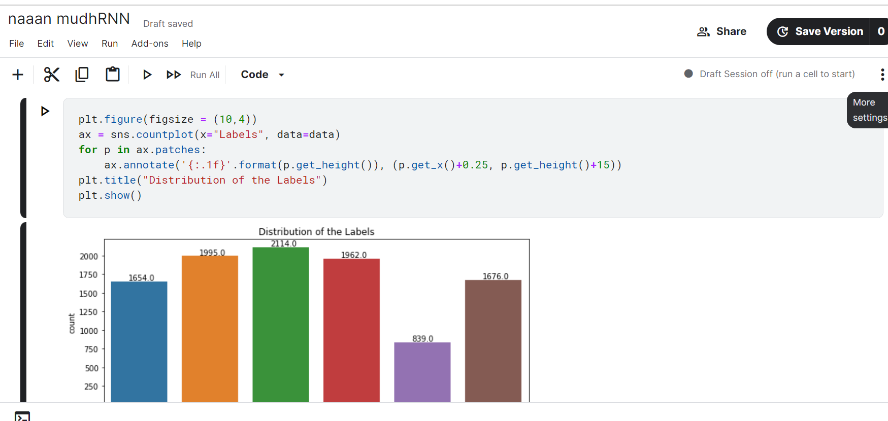
Outputs:

Slide 15

Detecting fake news:

Slide 16
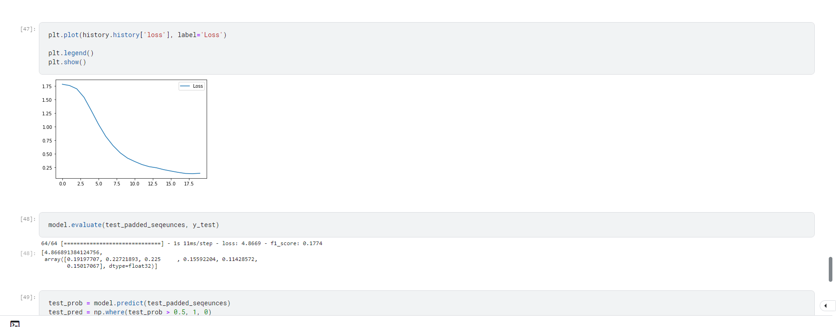

Slide 17
